Slide 2
Veterinary Medicine:
An Admissions Overview
Jenna Henshue
Director of Admissions
University of Wisconsin-Madison, School of Veterinary Medicine

Slide 3
What draws students to the field of Veterinary Medicine?
Science is exciting!
Respected profession
Love of Animals and People
Limitless opportunities:
  Private practice (small animal, food animal, equine, mixed)
  Zoo animal medicine, wildlife management
  Public health (emerging infections, food safety, environmental health)
  Academic medicine and specialty referral practice
  Industry/Research

Slide 4
Road to the SVM
A Bachelor’s degree is not required, however most students have completed their BA/BS before starting Veterinary school
Select the undergraduate institution of your choice
Select the academic major of your choice
  One major does not have an advantage over another
  Choose the major that interests you, and provides options (“Plan B”)
Take the Graduate Record Exam (GRE)
  Prepare for the GRE
  Consider taking a professional preparatory course
  Re-take the GRE, if necessary
  We will include the highest total score report from one test date in the application review

Slide 5
Required Coursework
8 credits of general chemistry, with lab
3 credits of organic chemistry
3 credits of biochemistry, with an organic prerequisite
4 credits of biology or zoology, with lab
6 credits of physics
3 credits of genetics or animal breeding
6 credits of English composition (writing-intensive course)
3 credits of statistics
6 credits of social science or humanities
17 additional semester credits

Slide 6
Residency
30 Schools/Colleges of Veterinary Medicine (US)
88 Positions within each new incoming class
60 positions held for Wisconsin Residents
28 positions held for Non-Residents
Class of 2020 Statistics
167 Wisconsin resident applicants
1,054 Non-Resident applicants
Total of 1,221 applicants

Slide 7
Academic Factors
Class of 2019 Statistics
Residents Non-Resident
GRE-Quantitative 157 157
GRE-Verbal 157 158
GRE-Writing 4.3 4.4
Undergrad GPA 3.64 3.80
Required GPA 3.65 3.80
Last 30 GPA 3.75 3.83

Slide 8
Non-Academic Factors
Experience working/volunteering with veterinarians
  300-400 hours under the supervision of a DVM
Experience working with animals
Other work experience
Awards and honors
Diversity of background, interests, experiences
Leadership potential
Maturity and goal orientation
Three letters of recommendation
Written statement of professional and personal goals

Slide 9
Applications
Veterinary Medical College Application Service (VMCAS)
  2017 application opens May 11, deadline September 15
  www.aavmc.org
Required Applicant Data Form (RADF)
  Submit directly to the School of Veterinary Medicine at UW-Madison
  2017 application opens June 1, deadline September 16
  www.vetmed.wisc.edu
Supplemental Application
  Submit directly to the School of Veterinary Medicine at UW-Madison
  Will be emailed to applicants in November; due in December
  ~$60.00 application fee

Slide 10
Decision timeline
Applicants are notified of their application decision status via postal mail
  Admit
  Waitlist #
  Regret
Admitted applicants must accept or decline position prior to April 15
Waitlist admission begins after April 15
Regret advising begins April 15

Slide 11
Dual-Degree offerings
The School of Veterinary Medicine offers several research opportunities and dual degree and certificate programs for DVM program students:
Student-hourly employment in a research lab
UW-SVM Summer Research Scholars program
DVM + MS (Comparative Biomedical Sciences)
DVM + PhD (Comparative Biomedical Sciences; other graduate programs)
DVM + MPH (Master of Public Health)
DVM + Certificate in Global Health

Slide 12
Dual DVM/PhD training program
An opportunity for a direct path to the dual degree prior to matriculation in to the DVM program
Completion of the DVM program and completion of the requirements of the PhD within 8 years
  Year One DVM
  Year Two DVM
  Year One PhD
  Year Two PhD
  Year Three PhD
  Year Four PhD
  Year Three DVM
  Year Four DVM
One individual admitted each year
Financial Support
  Graduated scholarship support throughout the DVM program
    $5,000/$10,000/$15,000/$20,000
  Graduate assistant stipend, tuition, health insurance provided during PhD training
Admissions Process
  Completion of all components of the DVM program application
  Additional essay based DVM/PhD Supplemental Application questions
  Top applicants interviewed via Skype

Slide 13
2016-2017 Cost of Attendance
Tuition and fees
Wisconsin Resident $22,762.00
Non-Resident $35,906.00
SVM students complete the FAFSA to determine loan eligibility
SVM students have the opportunity to apply for scholarships each year through a General Scholarship Application process coordinated by the SVM

Slide 14
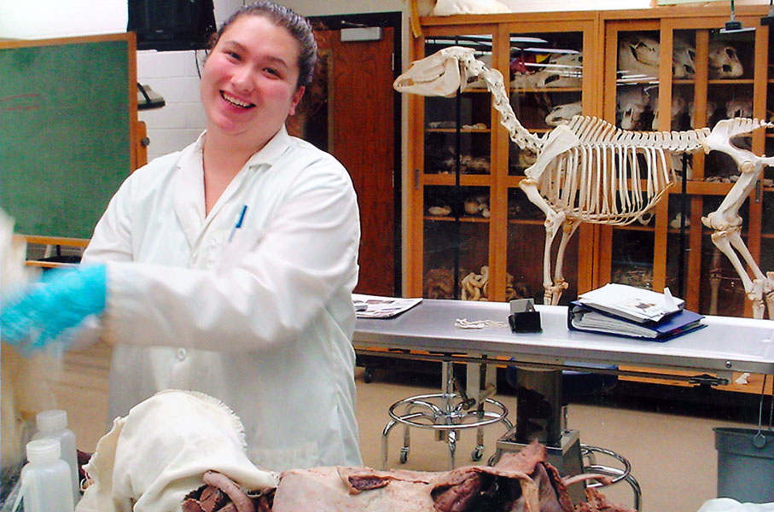
DVM Curriculum:
Year One
Veterinary Anatomy
Veterinary Histology
Veterinary Physiology
Radiographic Anatomy of the Dog and Cat
Veterinary Neuroanatomy and Neurophysiology
Veterinary Parasitology
Veterinary Nutrition
Health, History and Physical Exam
Introduction to the VMTH
Veterinary Ethics
(© L. Sullivan)

Slide 15
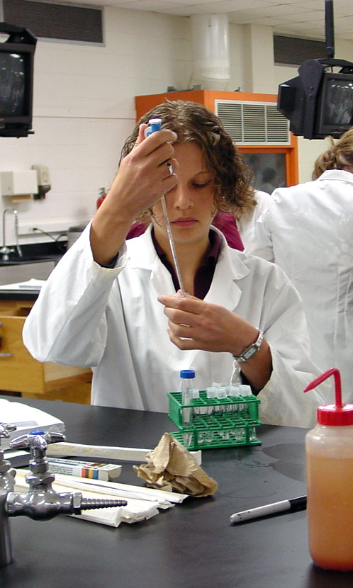

DVM Curriculum:
Year Two
Veterinary Immunology
Veterinary Bacteriology and Mycology
Veterinary Epidemiology
Veterinary Virology
Pathology
Veterinary Toxicology
Fundamentals of Anesthesiology
Surgery Fundamentals
Introduction to the VMTH
Veterinary Ethics

Slide 16
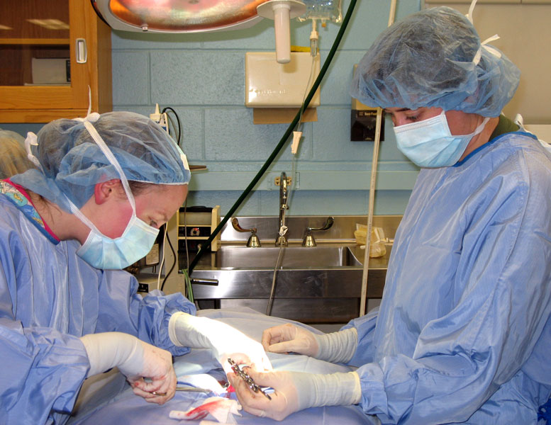
DVM Curriculum:
Year Three
Companion animal, Equine, and Food Animal medicine
Small and large animal surgery
Diagnostic and therapeutic techniques
Veterinary diagnostic imagining
Regulatory Veterinary Medicine and Public Health
Special Species Health
Professional Skills in Veterinary Medicine
Veterinary Ethics
(© L. Sullivan)

Slide 17
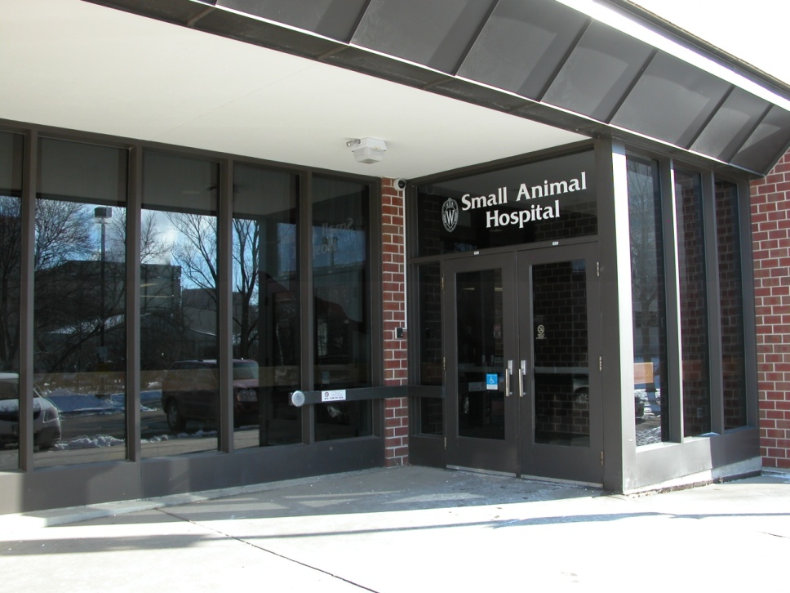
DVM Curriculum:
Year Four
Clinical rotations, Didactic courses, Externship
Select from one of five career emphasis options:
Small Animal
Large Animal
Mixed Animal
Food Animal
Other (goals not represented by other options)
  Aquatics
  Laboratory animal medicine
  Special species
  Research
(© C. W. Olsen)

Slide 18
Questions?
Jenna Henshue, Director of Admissions
jenna.henshue@wisc.edu
Carmen Reamer, Pre-Vet Advisor
carmen.reamer@wisc.edu
Office of Academic Affairs
School of Veterinary Medicine
2015 Linden Drive
Madison, WI 53706-1102
www.vetmed.wisc.edu
oaa@svm.vetmed.wisc.edu
(608) 263-2525

Slide 19




www.vetmed.wisc.edu

