Slide 1
Accepting PharmCAS Applications July 15, 2016 to March 1, 2017

Slide 2
Holistic Admission Review
The MCW PharmD Program is a rigorous, patient-centered educational experience designed to prepare and engage pharmacists to work in a variety of health care settings. Your passion, your future, your career starts with a holistic admission process.
Three letters of recommendation (required)
Pharmacy College Admissions Test (PCAT) score (required)
Candidate essay
Health related work experience (preferred, not required)
Community service (preferred, not required)
Completion of a baccalaureate degree or higher (not required)
Cumulative grade point average
Prerequisite grade point average
Completion of the pre-pharmacy curriculum

Slide 3
Admission Requirements
Achieve a cumulative grade point average of a minimum 2.00/4.0 scale for all courses completed. Prerequisite courses must have a minimum grade point average of 2.50 as calculated in PharmCAS.
Earn a grade of C or better in all science and math courses (a C- grade is not considered sufficient).
Earn a grade of B or better in all English and speech courses (a B- grade is not considered sufficient).

Slide 4
MCW Prerequisite Courses
General Biology
Advanced Biology with Laboratory General Chemistry I with Laboratory General Chemistry II with Laboratory Organic Chemistry I with Laboratory
Organic Chemistry II with Laboratory Physics
Calculus Statistics (general or biostatistics)
Economics (micro or macro)
English Composition I English Composition II Speech Communication
Four General Education Courses (no studio or performance)

Slide 5
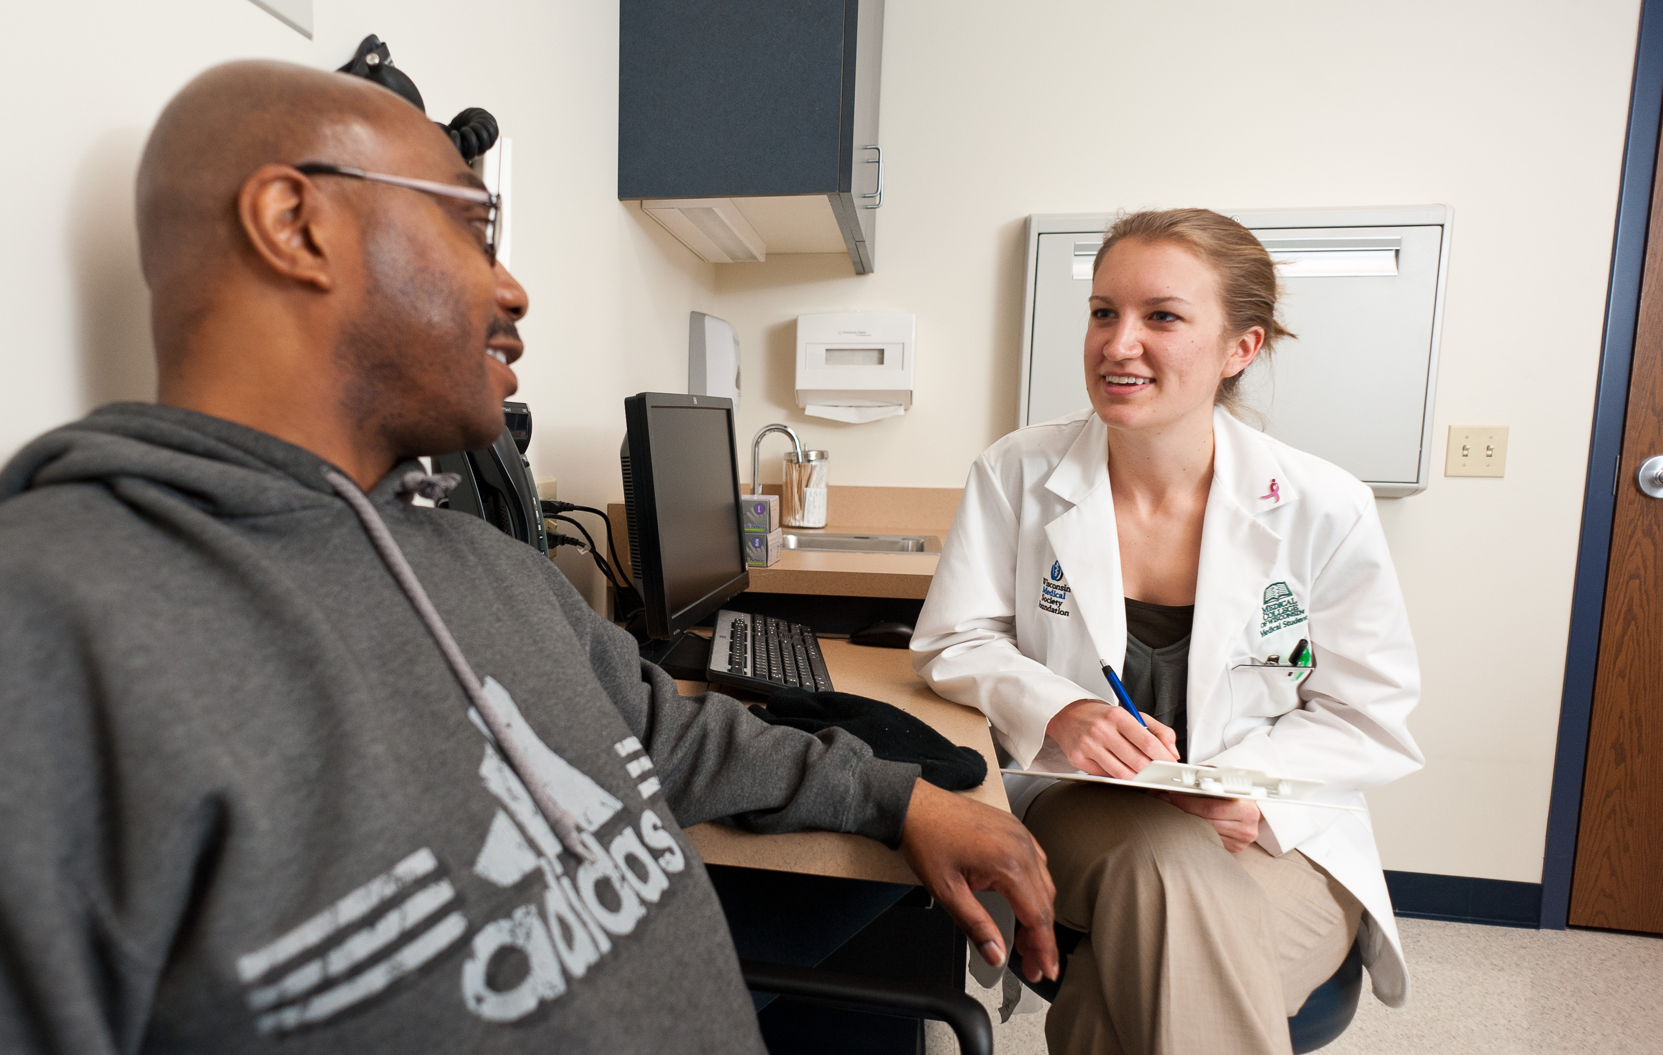
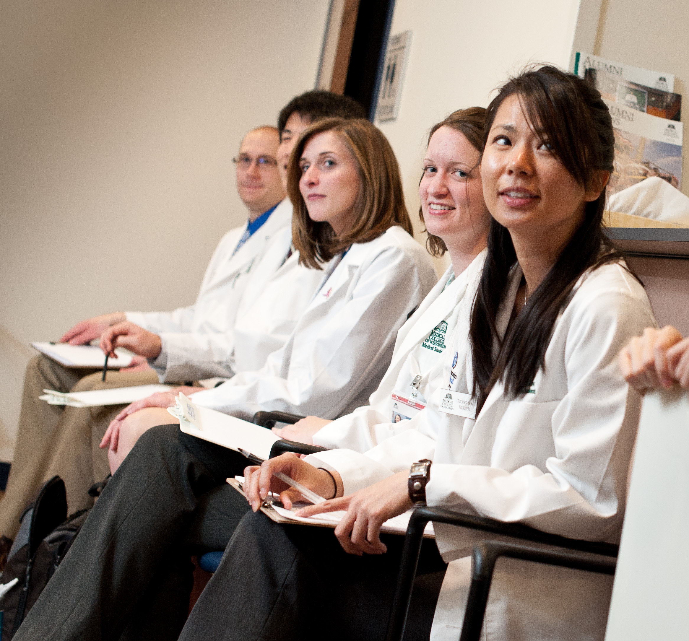
MCW Advantage
Dedicated to a small class size of 60-70 students.
Highly trained clinical and bio-pharmaceutical faculty.
Inter-disciplinary faculty from Medical School and Graduate School
Diversity of quality experiential education rotation sites.
Use of the latest technology in the classroom and labs.
Inter-professional practice during your second year.
Simulation lab experience with medical and nursing students.
Research opportunities.
Graduating 1 year earlier...means more experience, more opportunity, more options for the future.

Slide 6
Contact Us!
Shaun D. Keating Director of Enrollment 414-955-2852
skeating@mcw.edu
Kendra Kalscheur Enrollment Coordinator
414-955-2857
kkalscheur@mcw.edu
General Contact:
pharmacy@mcw.edu 414-955-7476
MCW Summer Expo Wednesday, July 6, 4-7 pm

