Slide 1
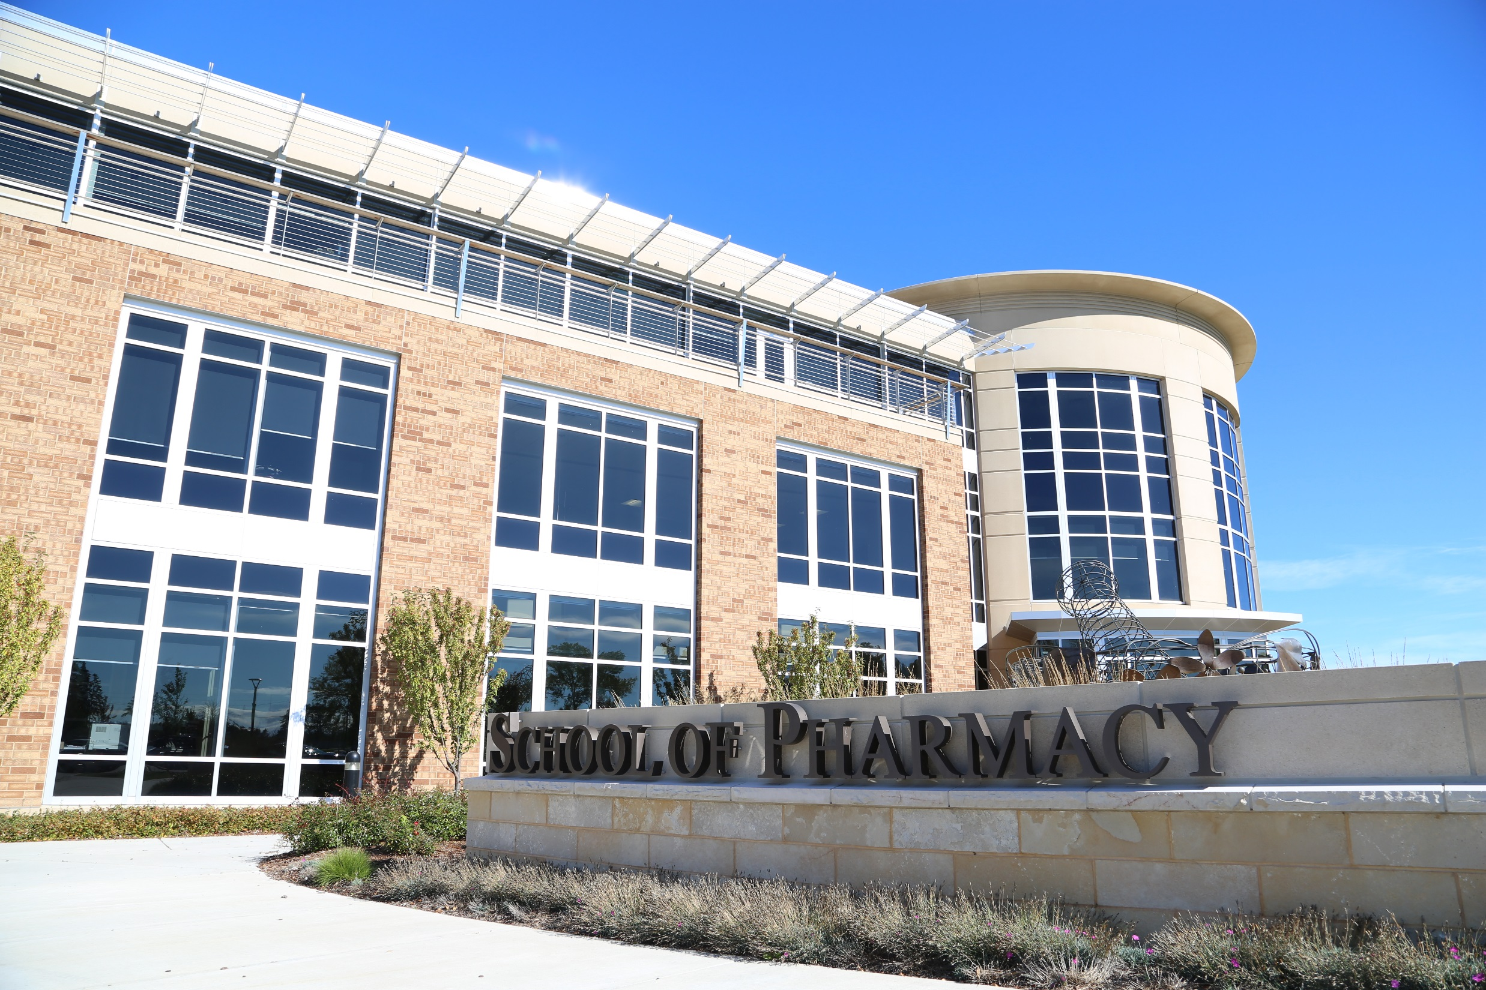

Slide 2
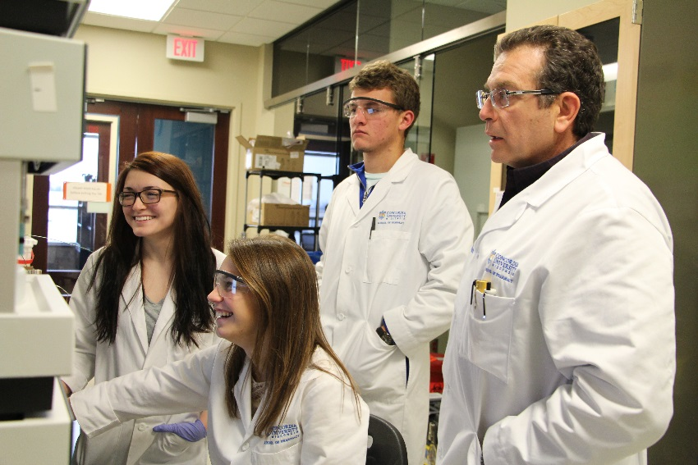
Student-Centered
Four-year program
Curriculum Focus: applied learning
through skill development labs and
practice experiences in each semester
Weekly exam blocks evenly space out
exams throughout semester
Faculty focus on teaching and mentoring
Curriculum framework promotes involvement in student organizations and professional development experiences

Slide 3
Experiential
Office of Experiential Education individually coordinates rotations with extensive healthcare partner network
IPPEs: 2-week block begins in 6th week of P1 year and each semester in P1 and P2
Elective IPPEs: available in P3 diversify and specialize professional development
APPEs: Eight blocks of 6-week rotations throughout P4 for advanced pharmacy practice skills
Post Graduate Residency Programs:
CUW sends graduates into residency programs at more than double the national rate
CUW’s PGY1 programs: Academic Leadership Emphasis and Urban Underserved Emphasis

Slide 4
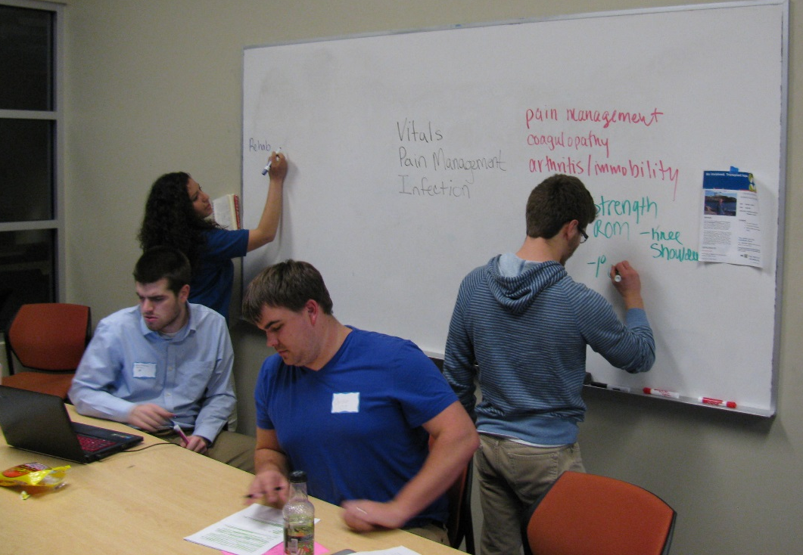
Interprofessional Education
Team-based healthcare case study simulations promotes unifying specialized healthcare knowledge for patient care
Diverse healthcare professional
degree program students:
Pharmacy
Nursing
Social Work
Occupational Therapy
Physical Therapy
Medicine
Certification in IPE available

Slide 5
Thank you!
Emmy Stoecklein
Director of Recruitment and Admissions
emmy.stoecklein@cuw.edu
262-243-2747
Sam Poullette
Admissions Counselor
sam.poullette@cuw.edu
262-243-2728

