Slide 1
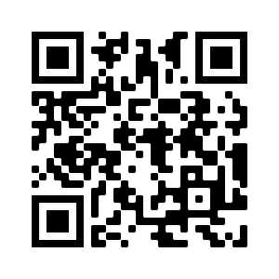
Notes:
QR Code for email sign up
https://iastate.box.com/v/isucvmprevet
https://iastate.zoom.us/meeting/register/tJModO2gpjwjHtRw6AQxUA--KDfCK7BWM3GJ

Slide 2
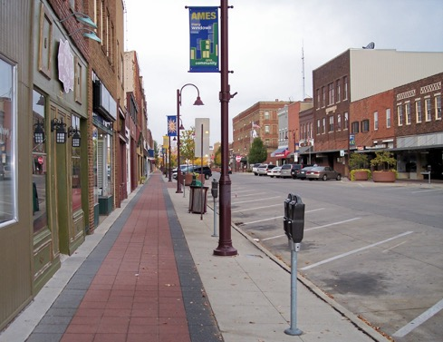
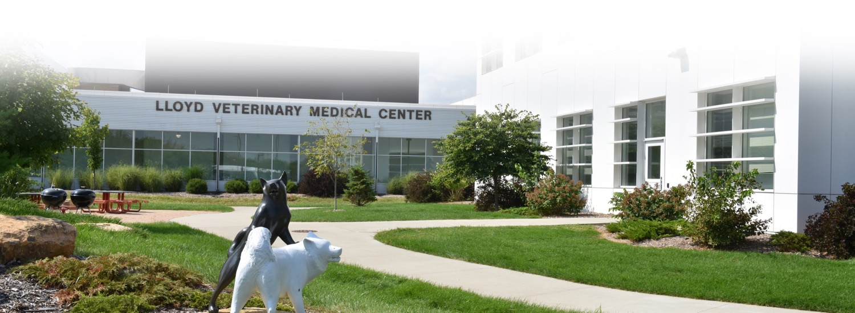
Ames, IA
Safe, small town feel with a lot to do
40 minutes from Des Moines
Highest concentration of veterinarians
Neighbors to USDA
Named “Best College Town” by 24/7Wall St.

Slide 3
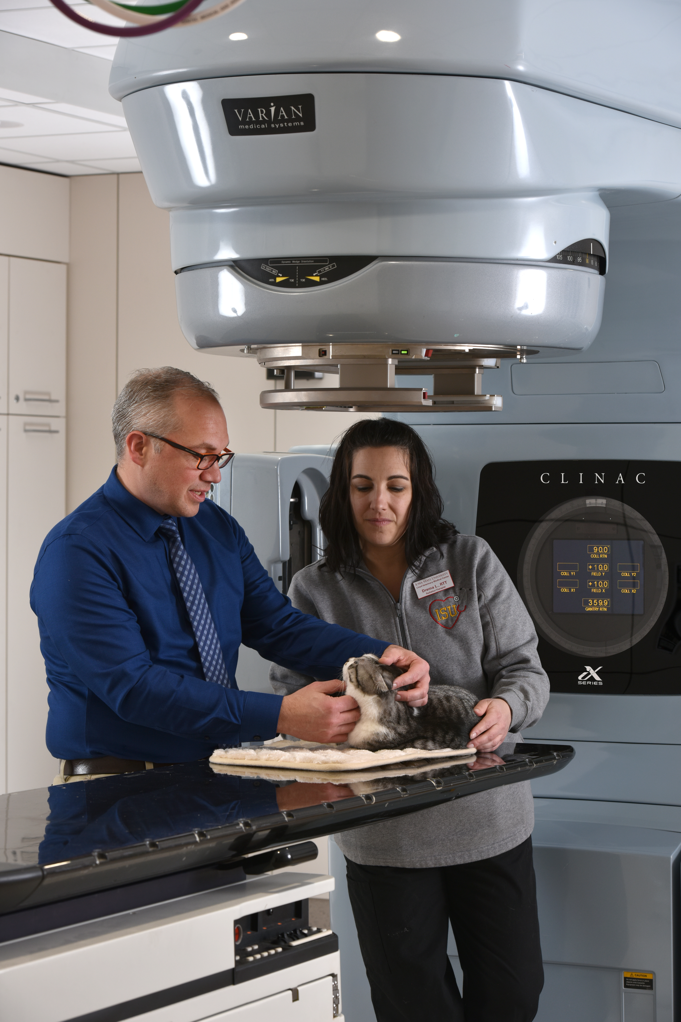
Small Animal Hospital
Primary Care
Internal Medicine
General Surgery
Oncology
Dermatology
Reproduction
Ophthalmology
Rehabilitation
Orthopedics
Cardiology
Radiology
Anesthesiology
Intensive Care

Slide 4
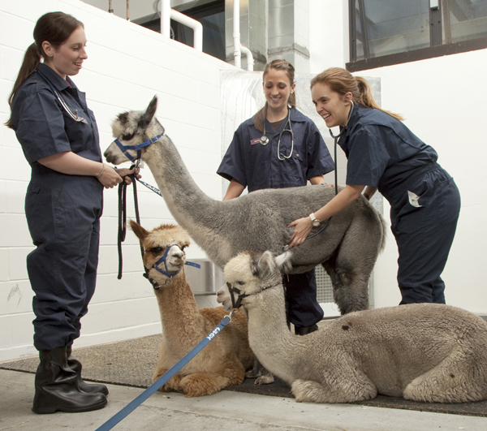
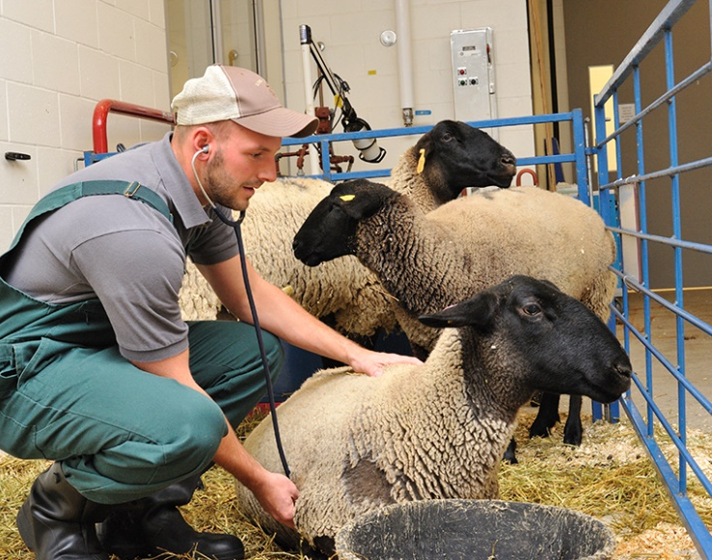
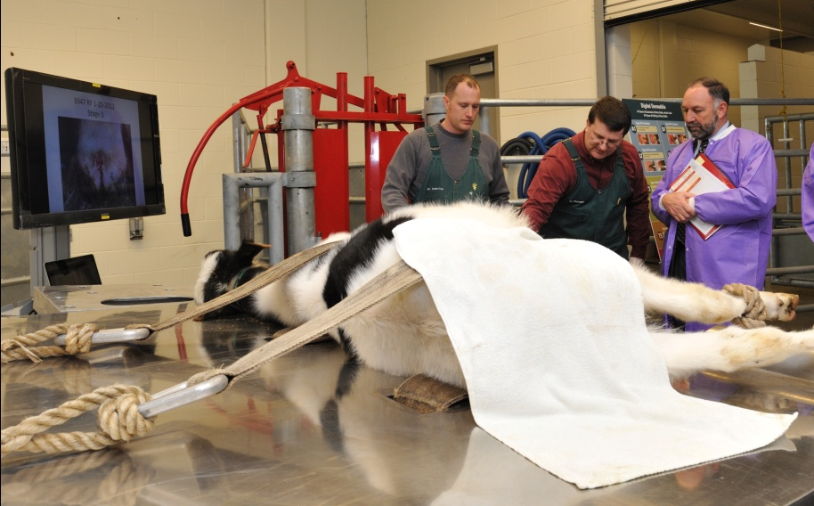
Large Animal Hospital
Food Animal Medicine
Food Animal Surgery
Equine Medicine
Equine Surgery
Reproduction
Embryo Transfer
Off-Site Services:
Veterinary Field Services
Swine Medicine Education Center
Great Plains Veterinary Education Center

Slide 5
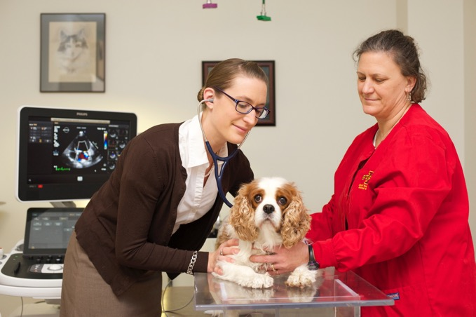
ISU CVM Research
Infectious (bacterial, viral, parasitic) diseases of livestock, poultry and people
Food safety
Cancer and enteric diseases of pets
Antimicrobial resistance
Welfare and behavior
Neuroscience
One Health
and several others…
Notes:
National Institute for Antimicrobial Resistance

Slide 6
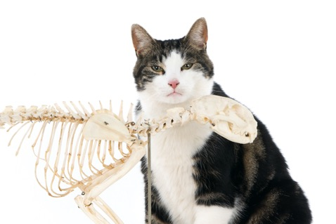
Our Curriculum at a Glance
1
FIRST YEAR – Normal anatomy & physiology
SECOND YEAR – Abnormal anatomy & physiology
THIRD YEAR – Transition to clinics
FOURTH YEAR – Clinical rotations
2
3
4

Slide 7
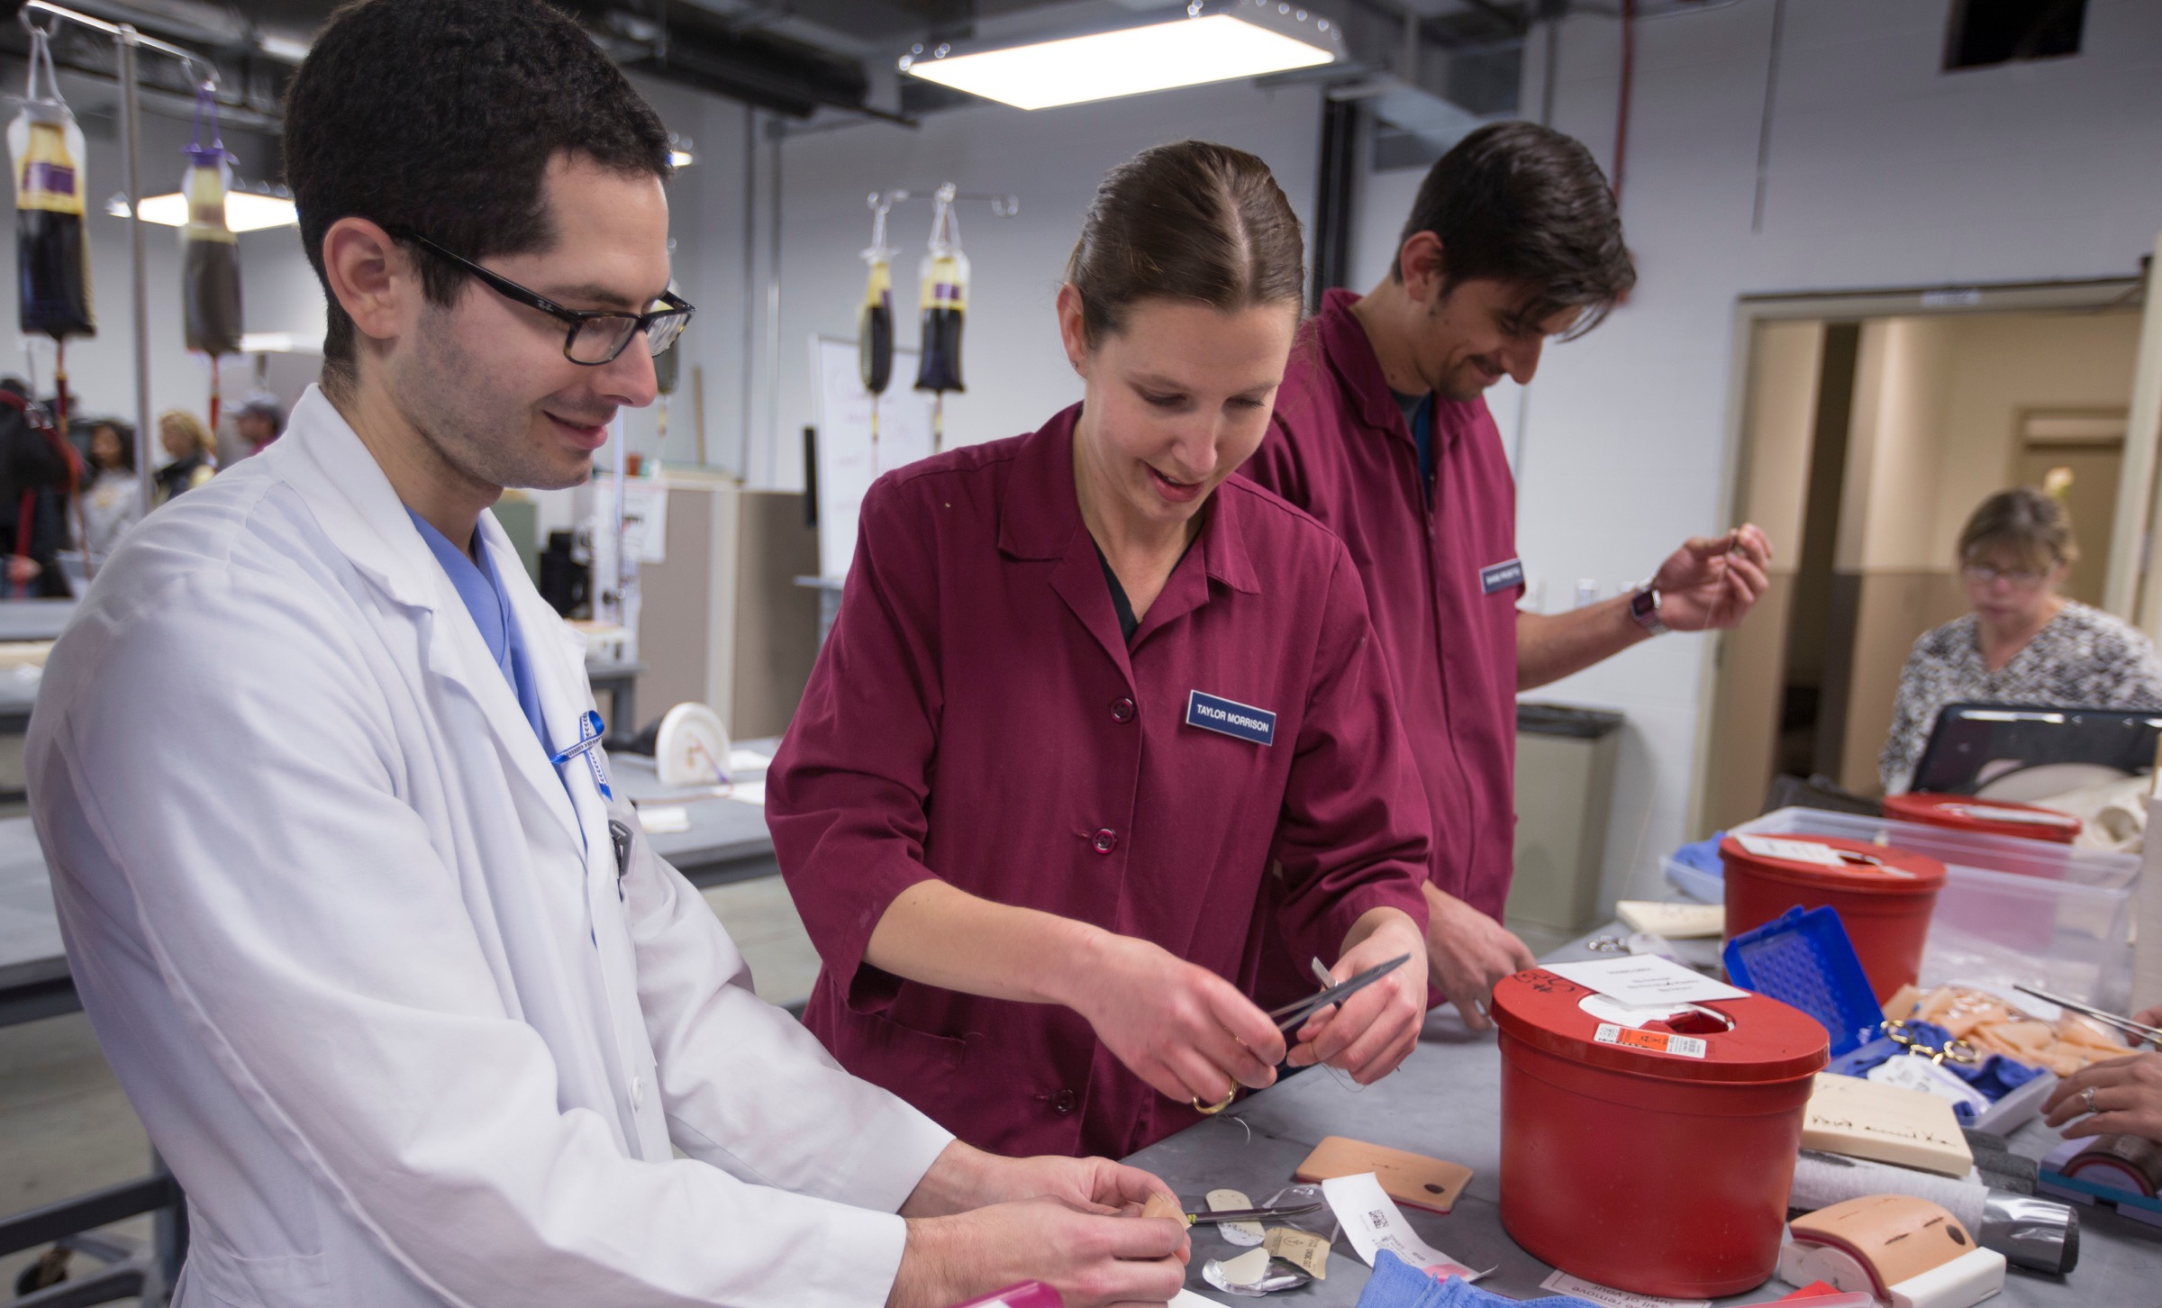
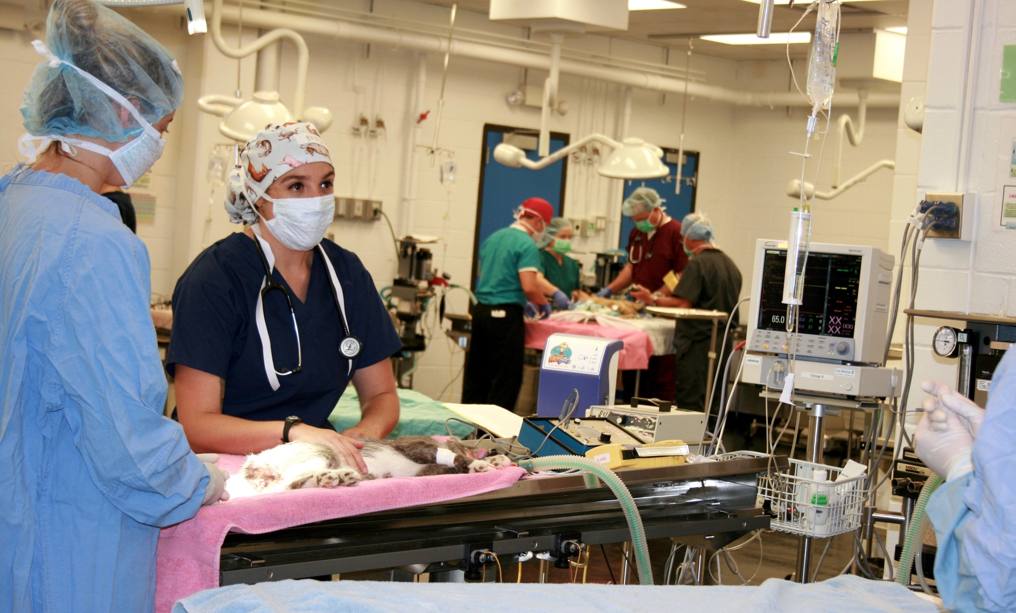
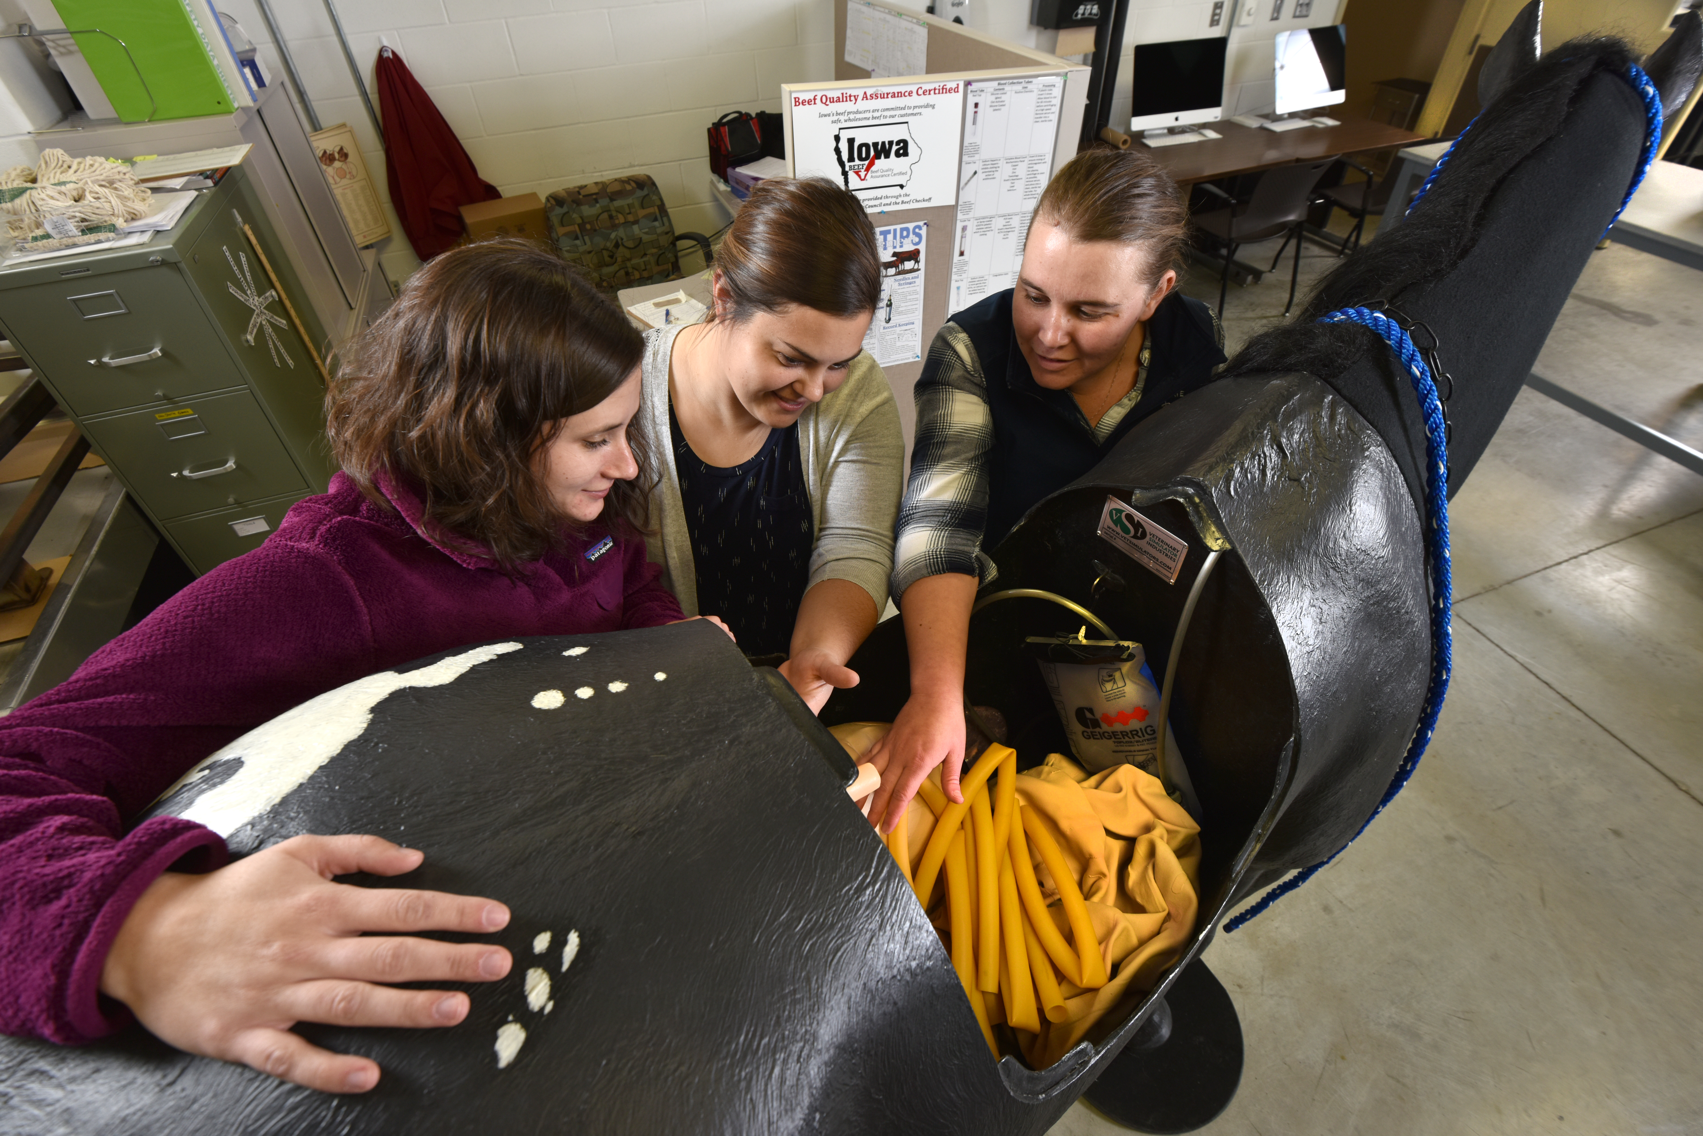
Early Hands-On Learning
Dystocia simulator
Suture placement/patterns
Equine colic model
Anesthesia simulator
Equine, canine, and alpaca venipuncture model

Slide 8
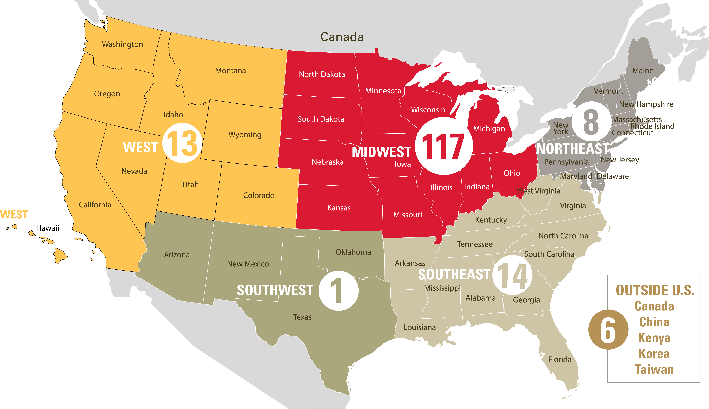
Available Positions - 160
Iowa residents – ~60
Contract positions - 30
4 North Dakota residents
26 Nebraska residents
Non-resident/Non-contract applicants – ~70
All applicants ranked within their applicant pool
Class of 2025

Slide 9
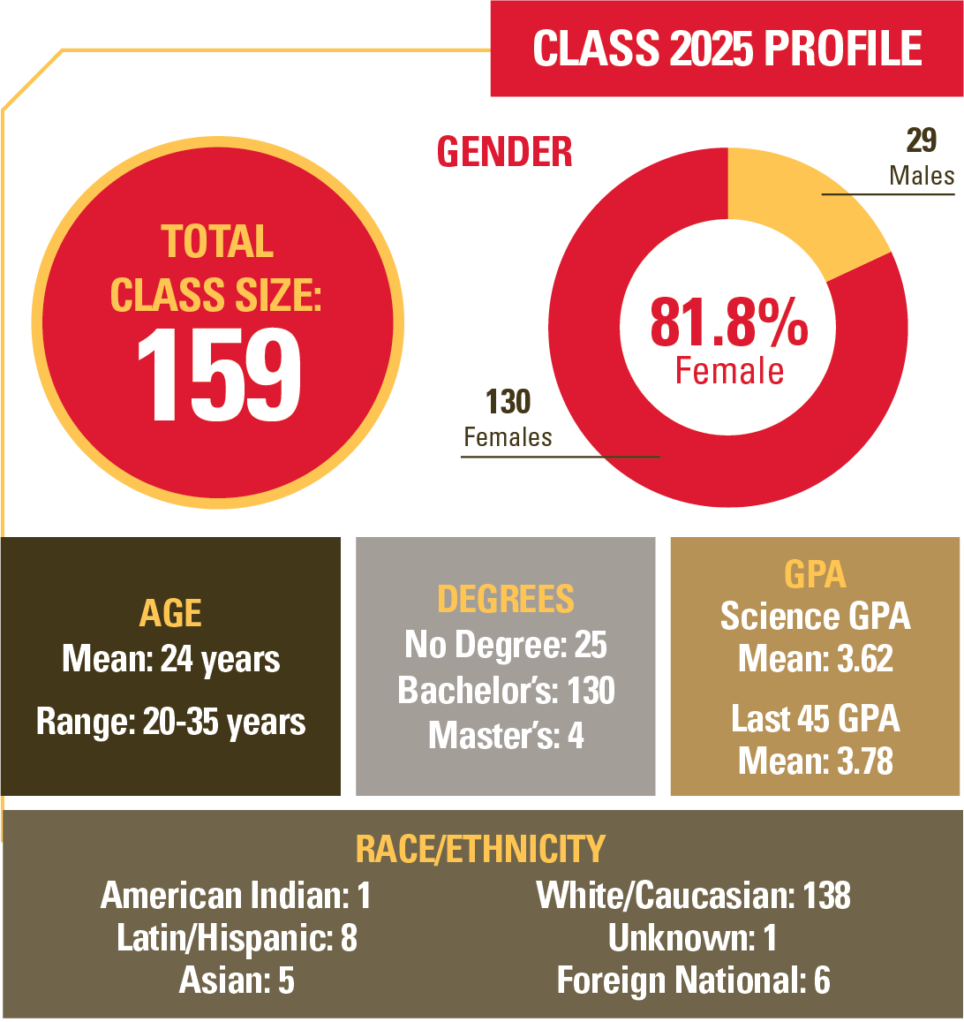

Slide 10
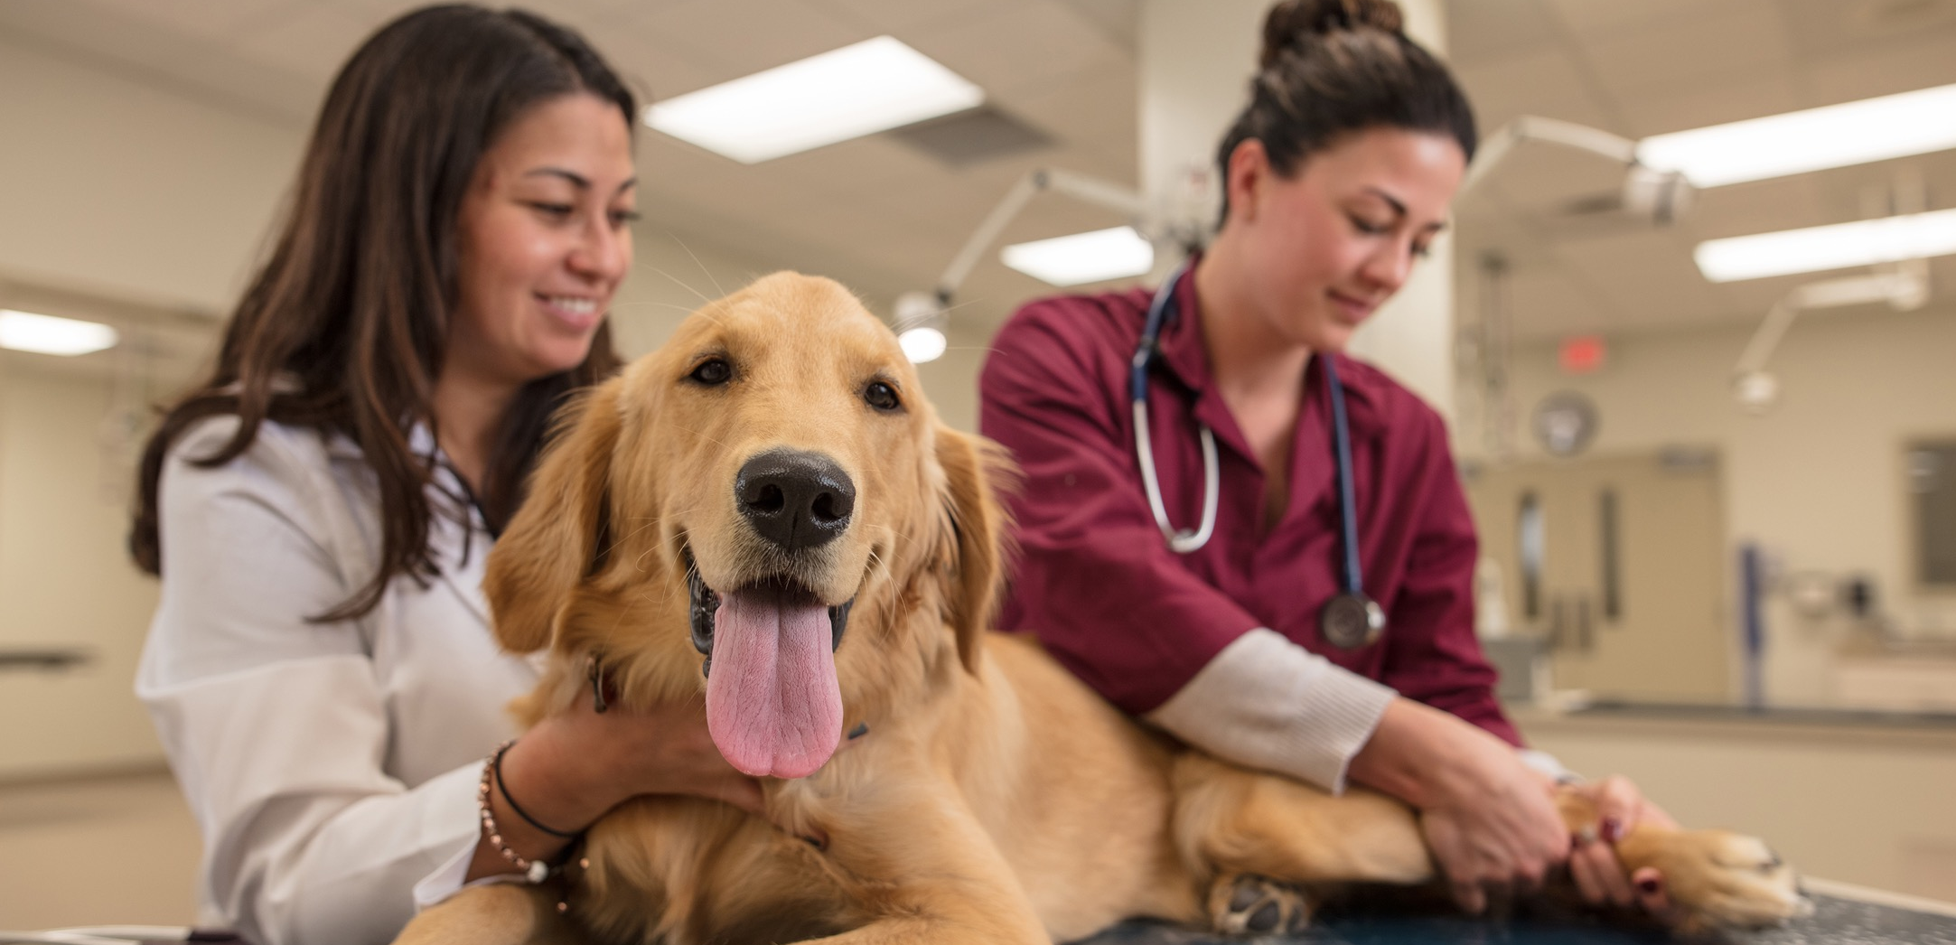
Anatomy of an Applicant Review
Academic Review 45%
GPA
Science GPA: 22.5%
Last 45 GPA: 22.5%
Committee Review: 45%
CASPer Test 10%
NO:
GRE
Interview
O CHEM II

Slide 11
Cost of Attendance
 | Resident | Non-Resident
Year | 2020-21 | 2020-21
Tuition & Fees | $25,498 | $54,582
Housing & Meals | $9,423 | $9,423
Books & Supplies | $1,041 | $1,041
Anticipated Transportation and Personal Expenses | $3,320 | $3,320
Total Costs | $39,282 | $68,366

Slide 12
Scholarships
Over $1.3 million awarded in scholarships in 2020-2021
Notes:
Goal is to double in the next 4 years. Incoming 1st year students are eligible for scholarships

Slide 13
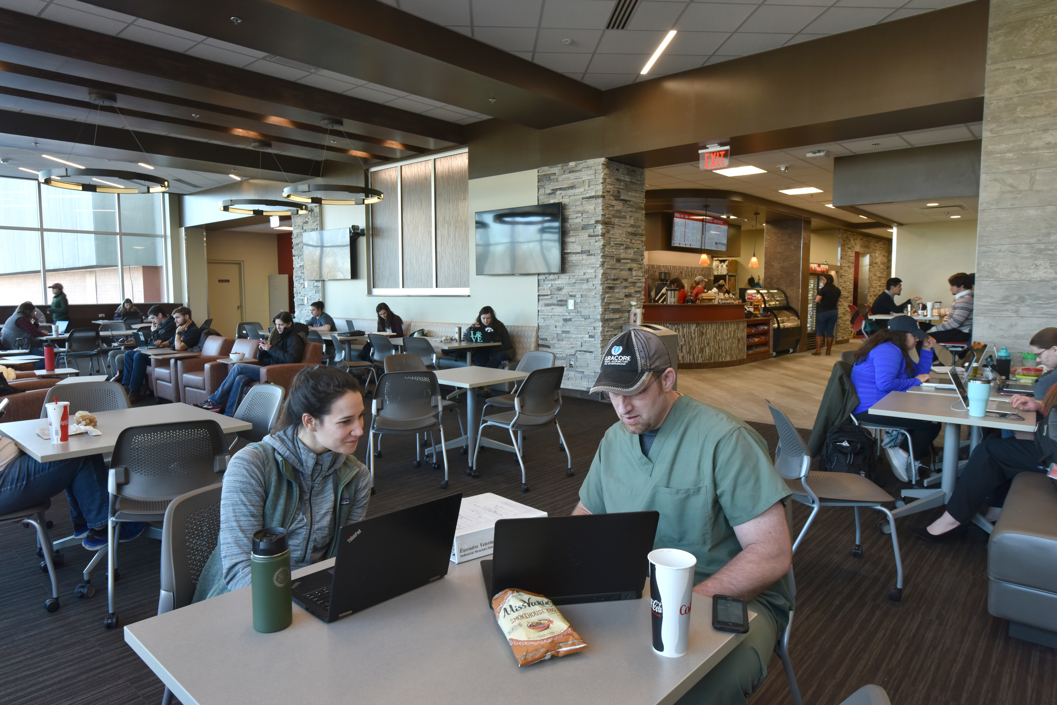
5 Tips for Pre-Vet Students
View requirements as your foundation
Stay organized
Keep in touch
Volunteerism and leadership are important
Learn to adapt and ask for help

Slide 14
Social Media
@ISUfutureDVM
ISUfutureDVM
@ISUfCVM
Iowa State University College of
Veterinary Medicine
Notes:
Facebook Live Tour Wednesday at 5:30 CST/ 6:30 EST

Slide 15
Thank you!
DGERBER@IASTATE.EDU
KKUEHL@IASTATE.EDU

Slide 17
Did you know?

Slide 18
Helpful Resources
Pre-Vet Checklist
Application Checklist
VMCAS
Vetschoolbound.org
Applytovetschool.org
Kathy Kuehl, Coordinator of Admissions (kkuehl@iastate.edu)
Deanna Gerber, Recruitment Coordinator (dgerber@iastate.edu)

Slide 19
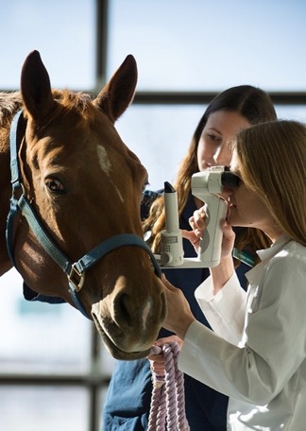
Flexible Degree Limitless Opportunities!
Private Practice
Corporate Veterinary Medicine
Federal Government
U.S. Army Corps and U. S. Air Force
Research
Teaching
Public Health
Food Supply Veterinary Medicine
Global Veterinary Medicine
Public Policy
Shelter Medicine
Notes:
One of the great things about veterinary medicine is that there really are countless things you can do with your degree. (Dr. Sato)

