Slide 1
Preparing for Careers in Health Care
Stefan Debbert, Chemistry
stefan.debbert@lawrence.edu

Slide 2
Today’s Meeting
Careers to Explore
Sign-up Sheet
First Year Classes, our advice
Your responsibilities, to find your passion
Joining a Career Community & Career Exploration
Canvas site for more info
Questions??

Slide 3
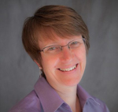


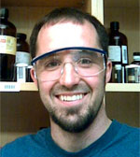
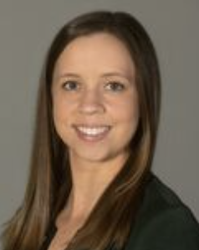
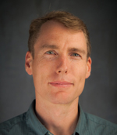
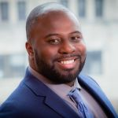

Pre-Health Careers Advising Committee
Get to know us and each other!
Table question:
Who is your favorite health care provider, either real or fictional? Why are they your favorite?
Matt Ansfield
Psychology, Briggs 313
Pre-med, PT & OT, psychiatry
Judith Humphries
Biology, YC 306
Pre-Vet; Global Health
Beth De Stasio
Biology, Steitz 331
Pre-med, genetic counseling
Mark Jenike
Anthropology,
Briggs 309
Global & Public Health
Stefan Debbert, Chair
Chemistry, Steitz 233
Pre-med, PharmD, PA
Allison Petrie
Asst. Director (Pre-Health)
Career Center
Doug Martin
Physics, YC 106
Pre-med, Pre-dentistry
Jesus Smith
Ethnic Studies,
Briggs 122
Pre-med, MPH

Slide 4
Careers we advise for:
Physician (MD, DO), Podiatry (DPM)
Nurse Practitioner (NP), Physician Assistant (PA)
Nurse (RN, MSN)
Physical Therapist (PT) and Occupational Therapist (OT)
Dentist (DDS)
Veterinarian (DVM)
Pharmacist (PharmD)
Public Health (MPH, DPH)
Genetic Counselor, Speech-Language Pathologist, Optometry, Therapists, and more

Slide 5
Sign-up for future invitations
Please sign in!
Look for emails from Allison Petrie
Reply and indicate the areas you wish to explore!

Slide 6
Our Goals
Helping you find and live your best life!
Facilitating Discernment & Preparation
Helping you sequence courses to fit your academic goals
(off-campus, major, languages, etc.)

Slide 7
STEM coursework
Goal: Ready for MCAT by Spring term of 3rd year!
This allows you to proceed directly from LU into medical school, but MOST LU students have "gap years" in between to strengthen their application!
Biology: Bio 130, 150, electives of your choice!
Genetics, Morphology of Vertebrates, Cell Bio, etc.
Chemistry: General (115, 116), Organic (250, 252)
Biochemistry: Chem 340 (prereq: Bio 130, Chem 250)
i.e. 4 or 5 terms of chemistry!
Physics: Phys 141, 151
Phys 141 doesn't require Calculus as a prerequisite, but does require a passing score on a math placement exam (ALEXS)!
We strongly recommend you engage with ALEXS as soon as possible!

Slide 8
Non-science courses: yes absolutely!
Take courses you think might be cool, and that you’re motivated to invest in!
Courses that might be relevant for MCAT:
  Psychology 100
  Social Psychology (Psyc 270)
  Anthropology: Cultural (Anth 110), Biological (130), etc.
First-Year Studies and other writing opportunities!

Slide 9
Next year: let’s reflect!
Health Career Exploration and Self-Reflection
(HESO 380, 2 cr)
  Informational interviews
  Panel discussions
  Facilitated discernment process
  Workshops on presenting your competencies
  Preparation for applications

Slide 10
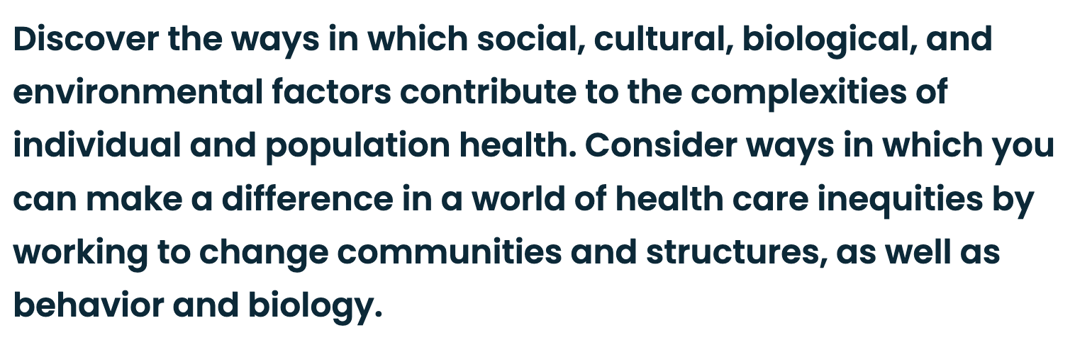
Health and Society (HESO) minor
- see website and your advisor for more details!

Slide 11

New LU-MCW Pharmacy
”3-3” program
Three years at Lawrence, then three at the Medical College of Wisconsin (Milwaukee)
Earn both Bachelor’s of Arts (in biology or biochemistry) and Doctor of Pharmacy (Pharm.D.) degrees in only six years!
Sign up in winter of first year, connect with MCW pharmacy faculty mentor
Talk to me (Stefan Debbert!) about this ASAP if interested!

Slide 12
Your “Jobs” (we help)
Test your passion!
Explore & develop your strengths
Show commitment to service
  Choose 2 long-term activities
Develop responsibility, discipline, compassion, empathy, problem-solving, collaboration skills…
Focus on becoming an interesting, whole, healthy adult

Slide 13
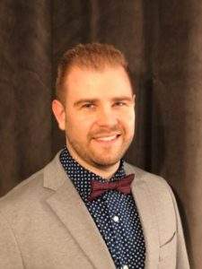
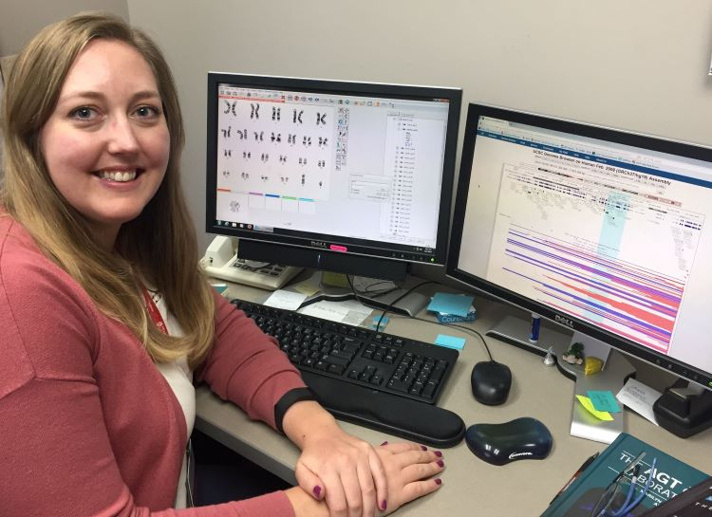
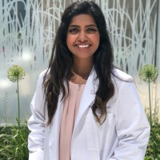
Explore!! Do you know about…
Podiatry (DPM)
  Sees patients
  Does surgeries
  Regular schedule
Genetic Counseling (MS)
  1:1 time with patients
  Long-term care
  Regular schedule
  Works with MDs
Physical Therapy (DPT)
  Hands-on care
  Regular schedule
Adam Biermann ’07
Kim Anderson, ’05
Rheya Upadhyaya, ’17

Slide 14
Start exploring your skills, strengths, weaknesses, personality, and professional disposition!
What are my greatest strengths and weaknesses?
Do I enjoying working as part of a team? Or do I prefer to work alone?
Am I comfortable dealing with emergencies and traumatic situations?
Am I comfortable making difficult decisions?
Can I lead others? Or am I better as an implementer? A care-giver?
Am I a good listener?
Am I comfortable working with people who are suffering, despondent, or non-compliant?
Notes:
Beth’s Slides

Slide 15
There are many ways to begin exploring your career priorities, values, personal traits, and interests…
Volunteer service
Summer internships
Undergraduate research (on-campus and elsewhere)
Health professions programs
Job shadowing or informational interviews
Part-time employment (e.g., CNA, EMT, Medical Assistant, Scribe, etc.)
Student organizations
Attend online fairs and info sessions
Films, websites, podcasts, books, and more!

Slide 16
Recommended volunteer opportunities
Volunteering is an excellent way for any student to gain experience, explore your passion for service, build important interpersonal skills, and heighten your awareness of issues impacting vulnerable populations.
Brewster Village, nursing home services
Boys and Girls Clubs of the Fox Valley
Pillars, homeless shelter
St. Elizabeth’s, ThedaCare Appleton, Children’s Hospital
Harbor House, domestic abuse shelter
Hospice Services, end-of-life care
Planned Parenthood
AIDS Resource Center of Wisconsin
Crisis Text Line (virtual)
LARY Buddy, mentoring for K-6 youth
VITAL tutoring, weekly tutoring to K-12 students
We encourage you to serve where you are most called to do so.
Visit the Center for Community Engagement and Social Change to get connected!

Slide 17
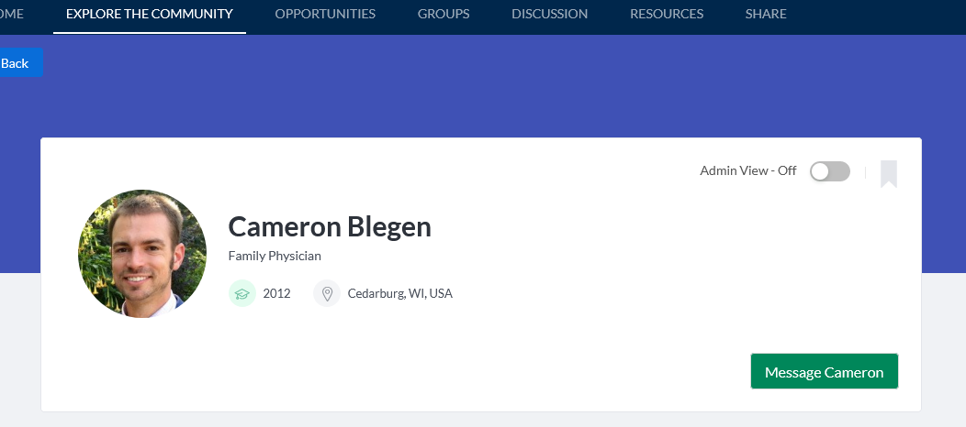
Lawrence alumni want to help you on your career journey!
Informational interviews are a great, safe option to begin exploring different areas of health care and medicine (John K & HESO 380 will help you prepare)
https://vikingconnect.lawrence.edu

Slide 18
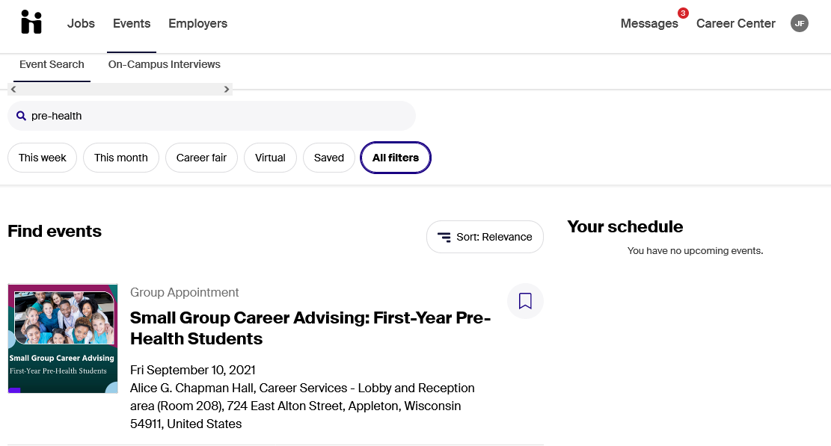
Sign up for a small group career advising session!
lawrence.joinhandshake.com/events ​
Type “pre-health” into search box and register for a session

Slide 19
Canvas site for more info
We'll add everybody that's signed in today!
Allison will share career resources here, such as:
  Listings of potential internships and research programs
  Opportunities for students underrepresented in medicine
  Resume resources
  Other ideas for career exploration
There are sections for various career paths

Slide 21


